Slide 1
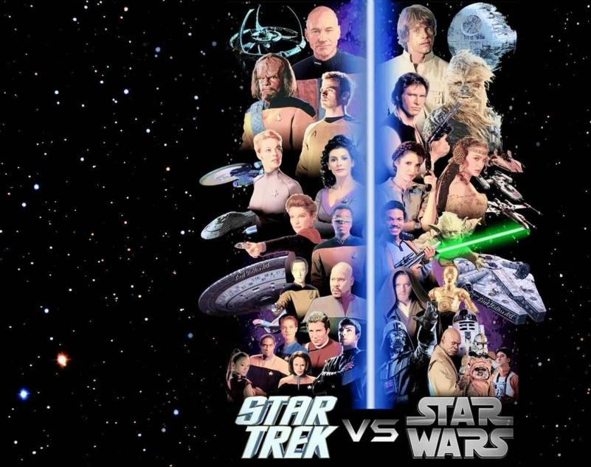
Star Trek VS Star Wars
Which Universe Is Better?
Wes Ward
Capstone for Nashville Software School
Data Analytics/DA8

Slide 2
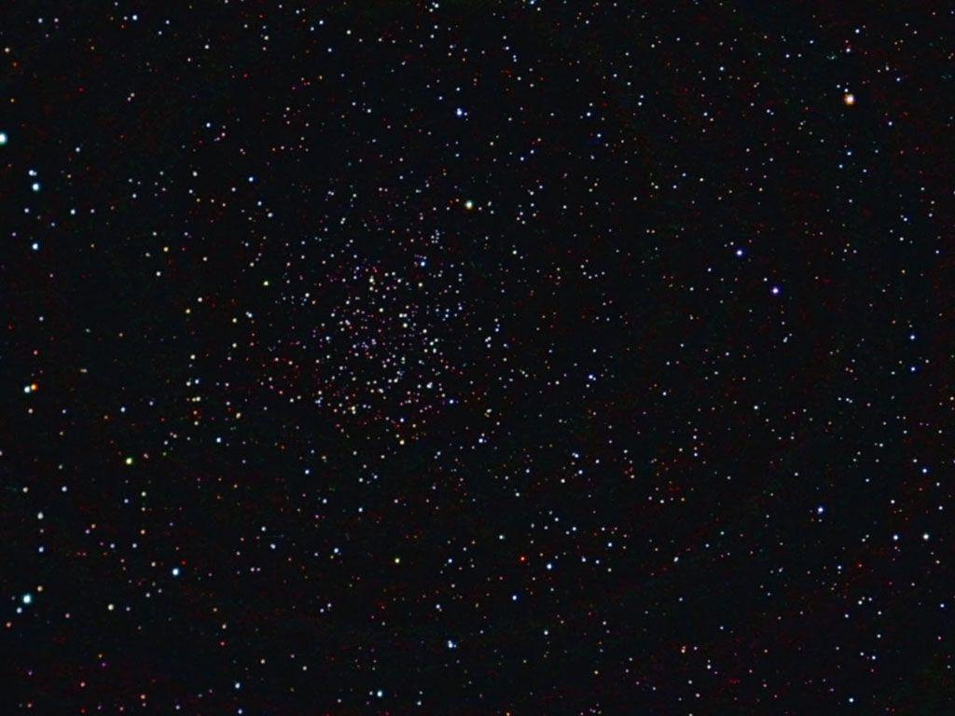
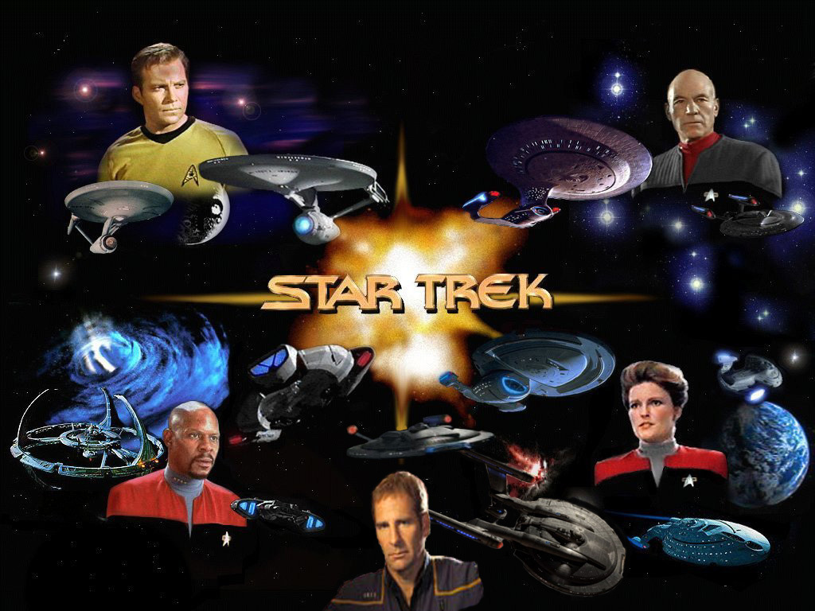
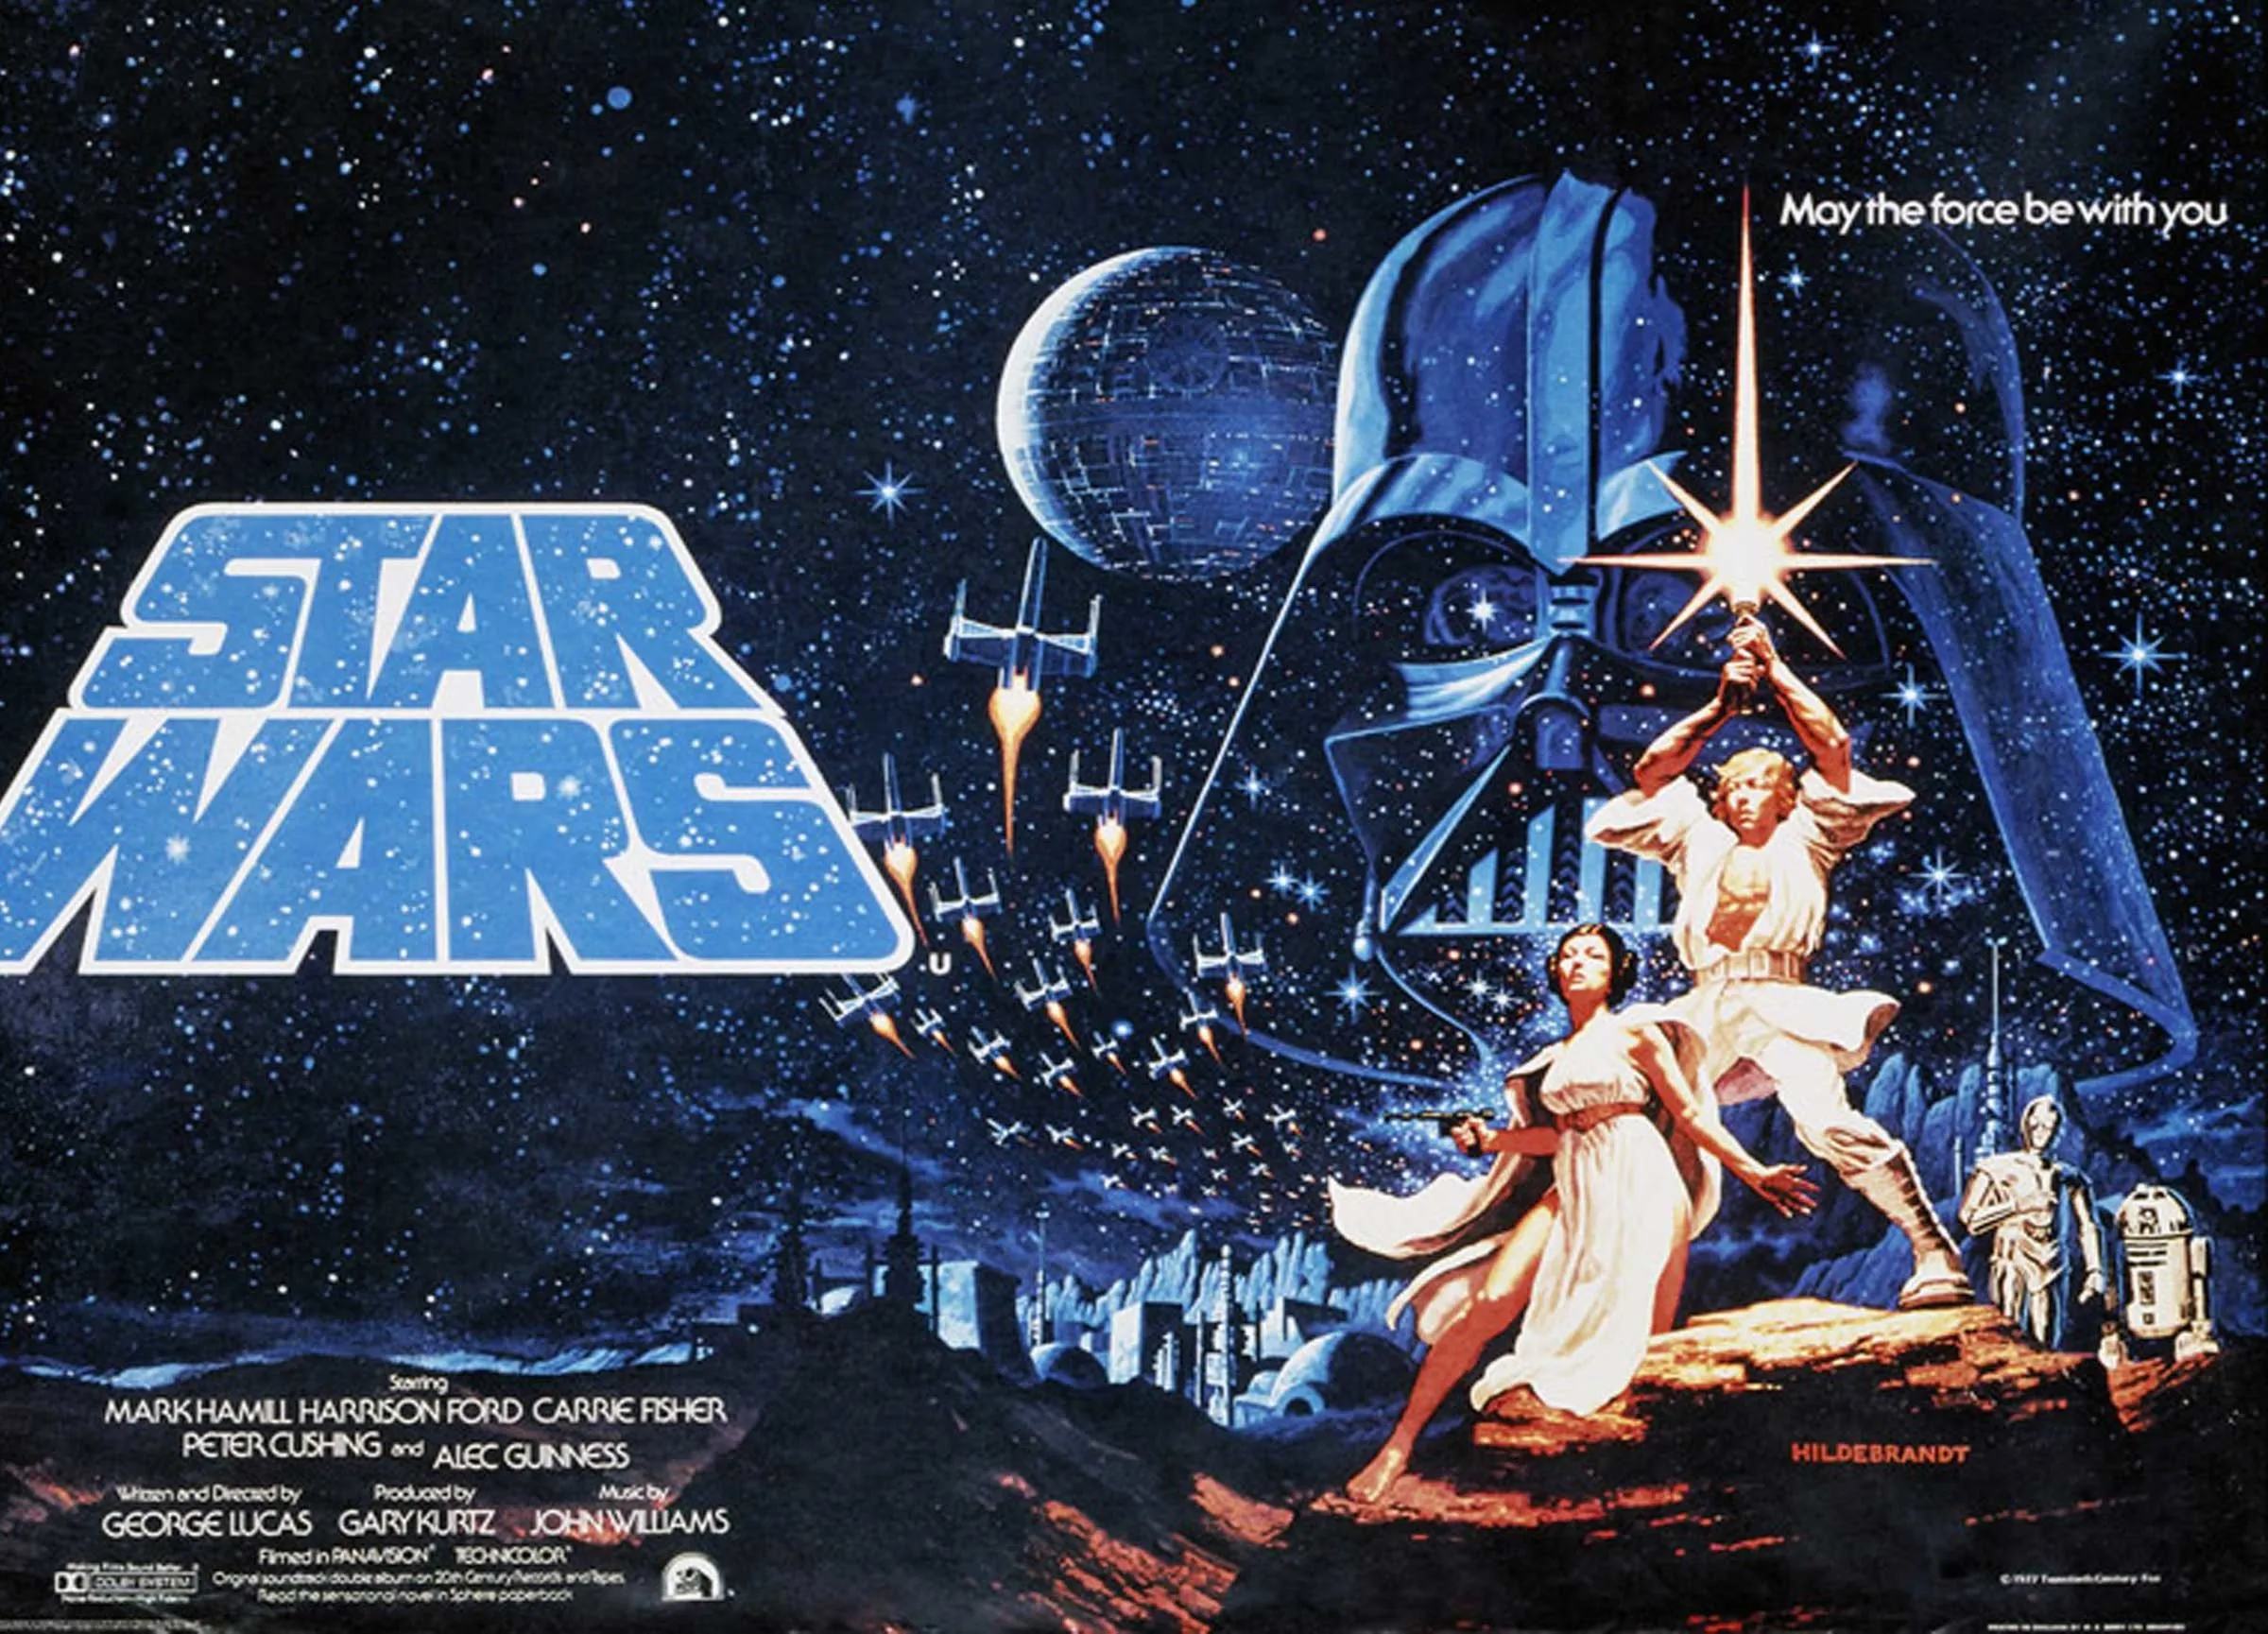
Motivation
The original goal was to compare the two biggest science fiction universes to determine which is better for the average individual living in it. After the first real comparisons, it was updated to compare the universes along with how the data is arranged, and how it correlate to the respective universe.

Slide 3
Data Sources
STAPI is a RESTful web service that provides data about the Star Trek universe, such as characters, planets, species, starships, and more. It has a simple and consistent interface that allows users to query its data easily. The URL for STAPI is http://stapi.co/.
Wookieepedia is a fan-made wiki that contains information about the Star Wars universe, such as characters, planets, species, vehicles, and more. The URL for Wookieepedia is: https://starwars.fandom.com/wiki/Main_Page.
For the Star Wars data, I used a good portion of the Wookieepedia scrape from this GitHub repository: https://github.com/dennisbakhuis/wookieepediascience. This repository contains scripts and notebooks that scrape and analyze data from Wookieepedia using Python and pandas. I modified some of the scripts to suit my needs and added some additional scraping functions. I would like to thank Dennis Bakhuis for creating and sharing this repository.

Slide 4
Challenges
Star Trek/STAPI Data
Very categorized
Often booleans only
Available for few entries
Initial STAPI Install Difficulty
Star Wars/Wookieepedia Data
Very Descriptive
Messy
Lack of Consistency
Fan Wiki
Trial and Error for Loops and Data

Slide 5
Universe Differences
Star Trek:
Clean
Orderly
Categorized
Pseudo-Scientific
Star Wars:
Messy
Diverse
Descriptive
Spiritual

Slide 6
Character Data
Star Trek/STAPI Data
Many fields to categorize Characters
Name
Gender
Height
Weight
Blood Type
Mirror/Alternate Reality/Fictional
Most of these fields are blank.
No other physical descriptions.
Star Wars/Wookieepedia Data
Many fields to describe Characters
Name
Gender
Height
Weight
Species
Homeworld
Affiliation
Most of the descriptions are difficult to group, often sub-dictionaries.

Slide 7
Characters

Slide 8
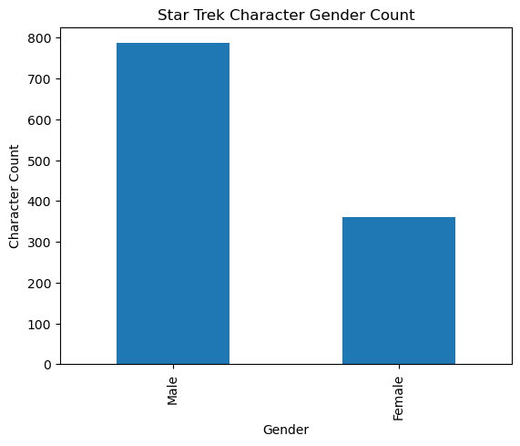
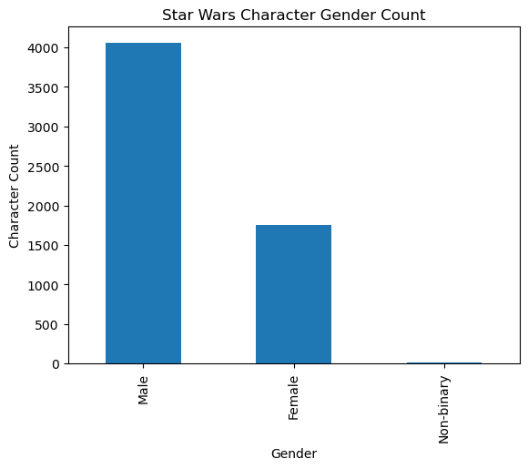
Character Data
Both Universes had similar character counts ~ 7000+
Both universes have twice as many male as female characters.
Star Wars has Non-binary characters.
Star Trek has mostly non-described characters. We do not know if this is because it is not known or if it is because it cannot be categorized.

Slide 9
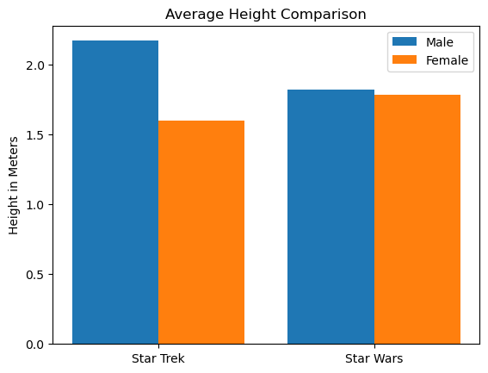
Character Height Averages
Star Trek male characters average over 2 meters tall, while female characters average just over 1.5 meters tall.
Star Wars male characters average around 1.8 meters and female characters average 1.7 meters.

Slide 10
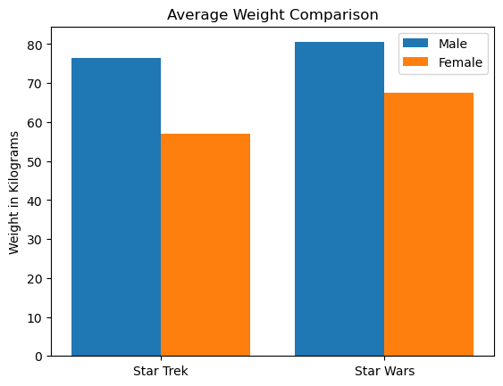
Character Weight Averages
Star Trek male characters average 77kgs, while female characters average just over 56kgs.
Star Wars male characters average 80kgs, and female characters average 69kgs.

Slide 11
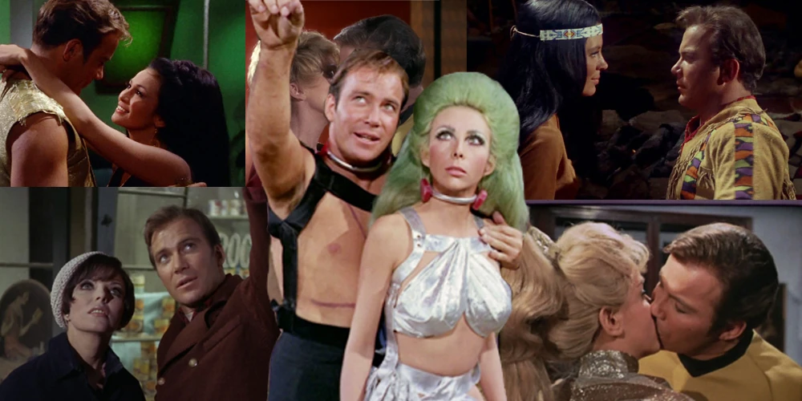
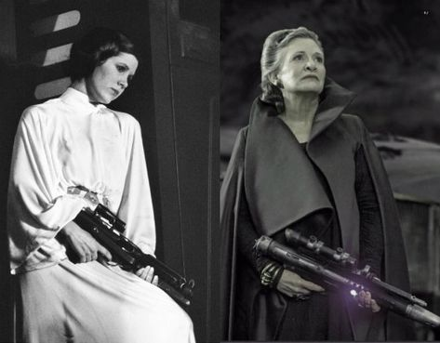


Character Observations
Star Wars is primarily male characters, but female characters are not damsels in distress. They typically have equal footing and standing as male characters.
Star Trek characters are easily categorized as manly men, diminutive women, or alien.
While there are not many, non-binary characters are also integral to the Star Wars universe.

Slide 12
Species Data
Star Trek/STAPI Data
Many fields to categorize
Name
Homeworld
Warp Capable
Extra Galactic
Spaceborne
Humanoid
Reptillian
Non-corporeal
Transdimensional
The majority of these are Booleans, and there are no other physical descriptions.
Star Wars/Wookieepedia Data
Many fields to describe species
Name
Average Height
Skin Colors
Hair Colors
Eye Colors
Distinctions (tendrils, face painting, horns, etc)
Social/Cultural Distinctions
Homeworld
There are lots of descriptions, and very difficult to group together.

Slide 13
Species

Slide 14
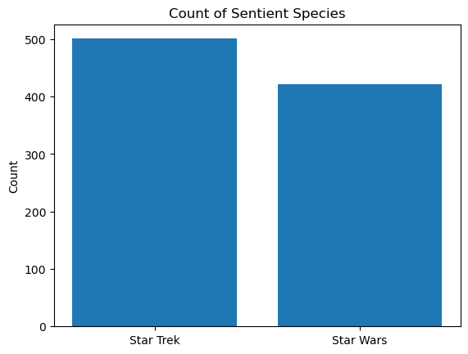
Sentient Species
Star Trek has 759 total species listed, of which, 501 were sentient.
Star Wars has 1051 total species listed, of which 422 were sentient.
Star Trek information had to compiled by determining humanoid and warp capable.
Star Wars involved cleaning data.

Slide 15
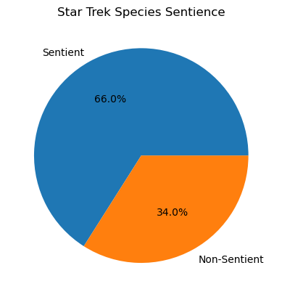
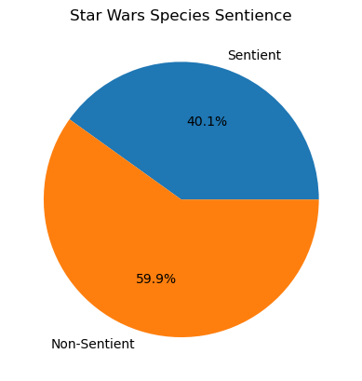
Sentient Species
Star Trek has 66% of all species as sentient, where Star Wars is less than half.
Star Trek information had to compiled by determining humanoid and warp capable.
Star Wars involved cleaning data.

Slide 16
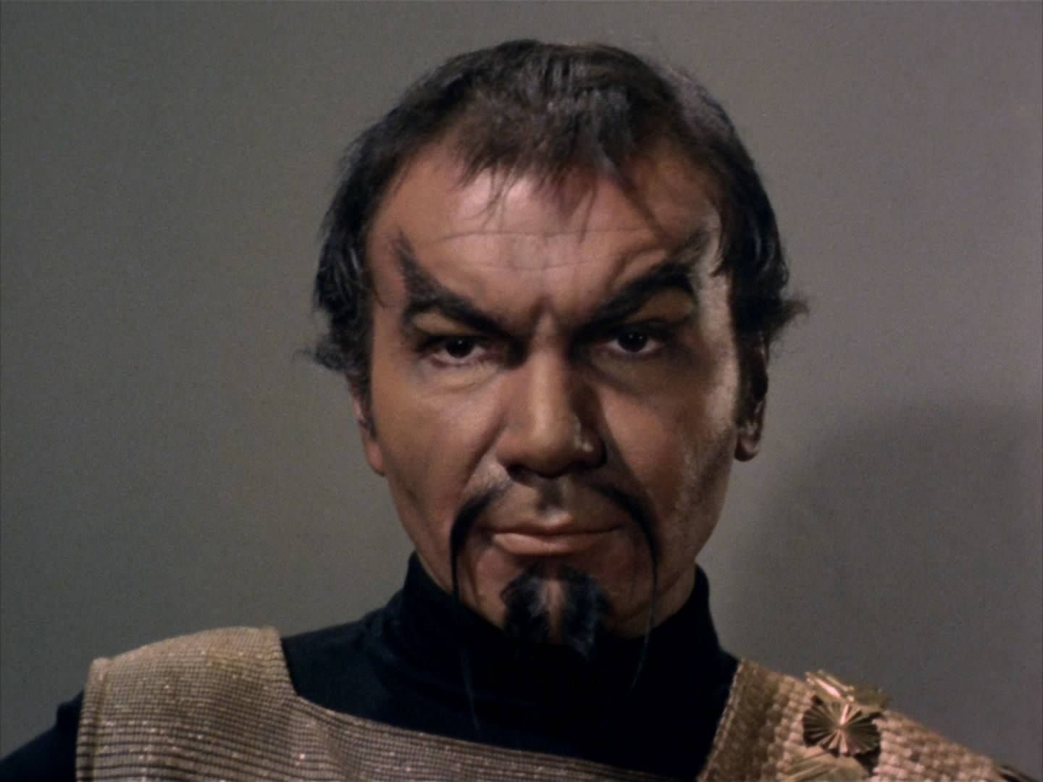


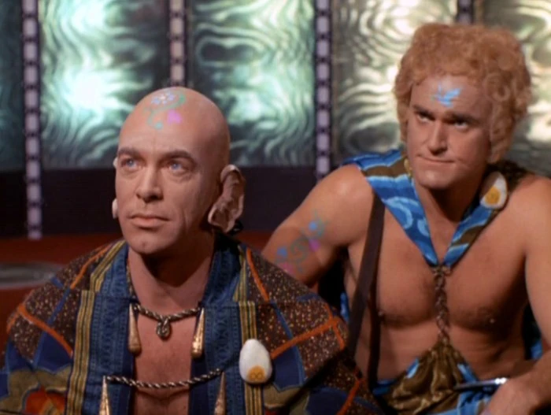
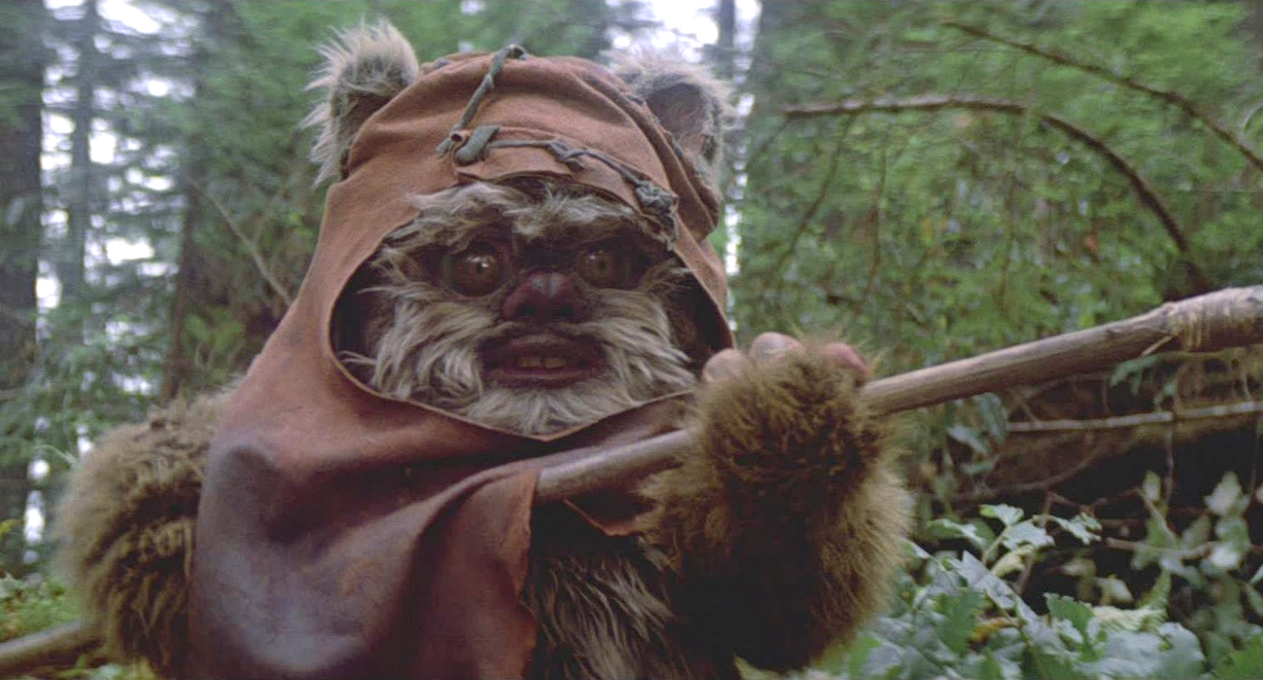
Sentient Species
Why does this matter?
Star Trek deals with species it can interact with on an intellectual level.
Star Wars is more “realistic” with farming, exploring flora and fauna of planetary bodies.
Both also have species fans would rather forget.

Slide 17
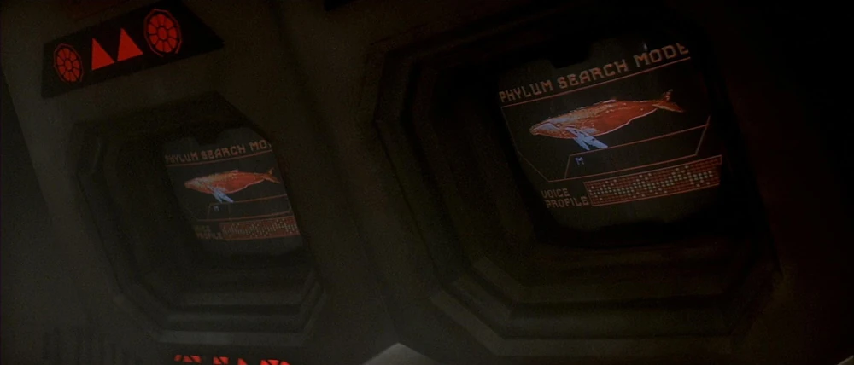

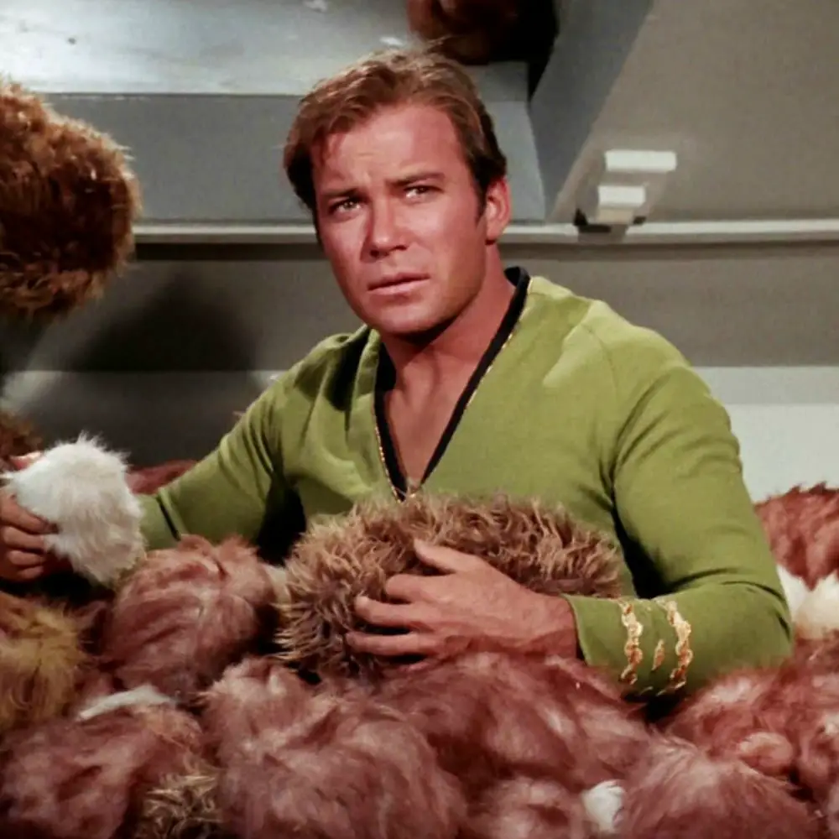
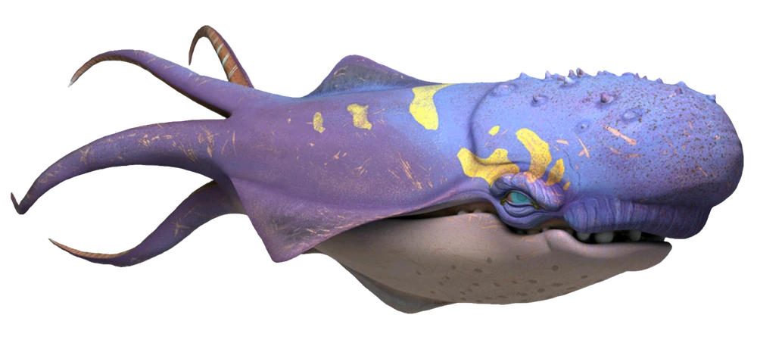
Non- Sentient Species
There are some similar species.
There are some out-there species.

Slide 18
Astrological Object Data
Star Trek/STAPI Data
Not many fields, very easy to compare.
Name
Type
Location
Total of 23 Types of Objects:
8 Planet types
2 Moon types
Remainders include Quasars, Nebulas, Sectors, etc.
Star Wars/Wookieepedia Data
Many fields, very difficult to group data
Name
No built-in Types
Had to piece together ways to pull just planets and moons
There are lots of descriptive items including:
Atmosphere
Climate
Population
Species (native and immigrated)
Flora/Fauna
Major Exports
Key Places

Slide 19
Astrological Objects

Slide 20
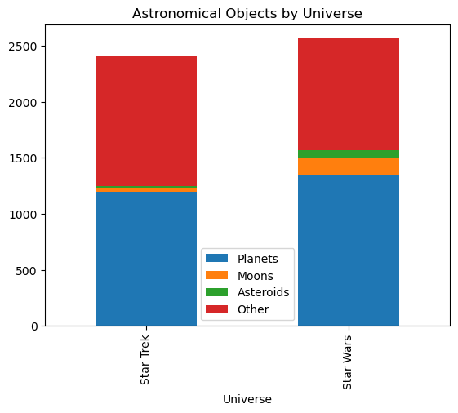
Astrological Object Data
Star Trek has 2404 Astronomical Objects
1197 Planets
32 Moons
20 Asteroids
1155 Other
Star Wars has 2562 Astronomical Objects
1352 Planets
145 Moons
73 Asteroids
992 Other

Slide 21
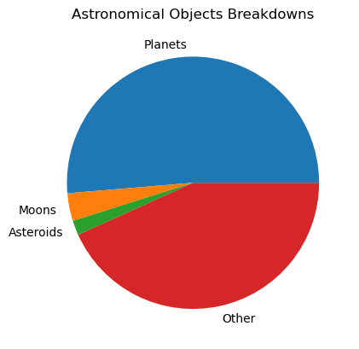
Astrological Object Data
Combining both universes, and planets account for 51%, Moons account for just under 4%, and asteroids account for just under 2%.

Slide 22

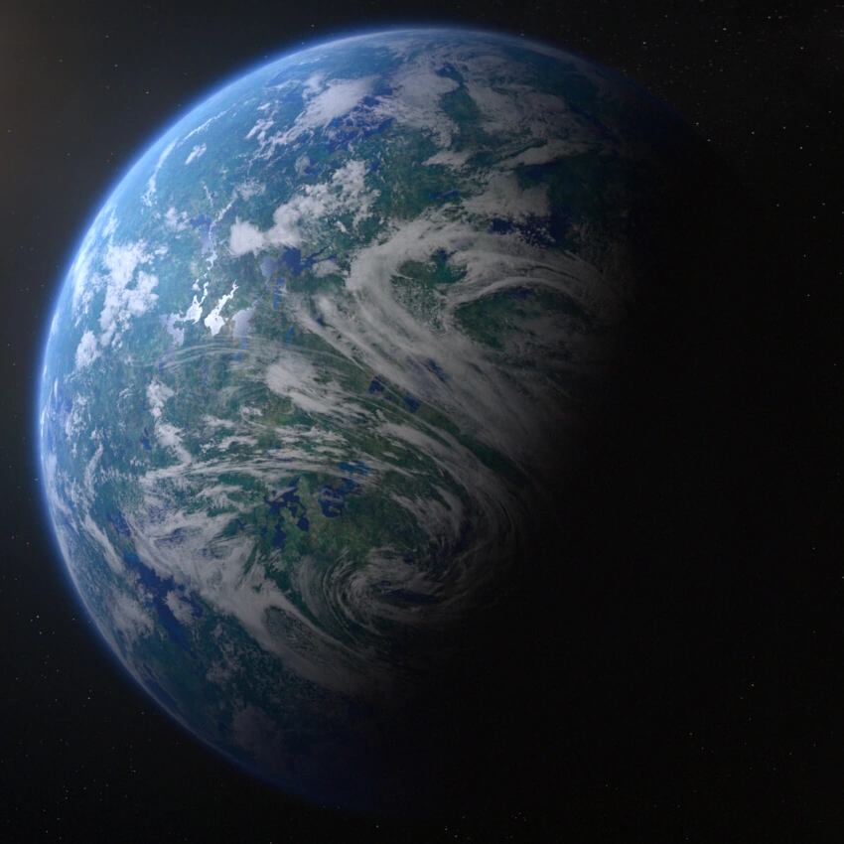
Astrological Object Data
Star Wars is 3-4 times as likely to have Moons or Asteroids than Star Trek.
Star Wars moons often have atmospheres and habitable climate.
Two of the first three Star Wars movies have major battles on or around moons.

Slide 23
Spacecraft Data
Star Trek/STAPI Data
Required two datasets with little data
Spacecraft
Name
Class
Spacecraft Class
Class Name
Number of Decks
Warp Capable
Species
Star Wars/Wookieepedia Data
Very detailed and descriptive data.
No consistent spacecraft fields.
Required:
Pulling all manufactured objects
Stripping out droids
Sorting through classes to determine spacecraft and combining

Slide 24
Spacecrafts

Slide 25
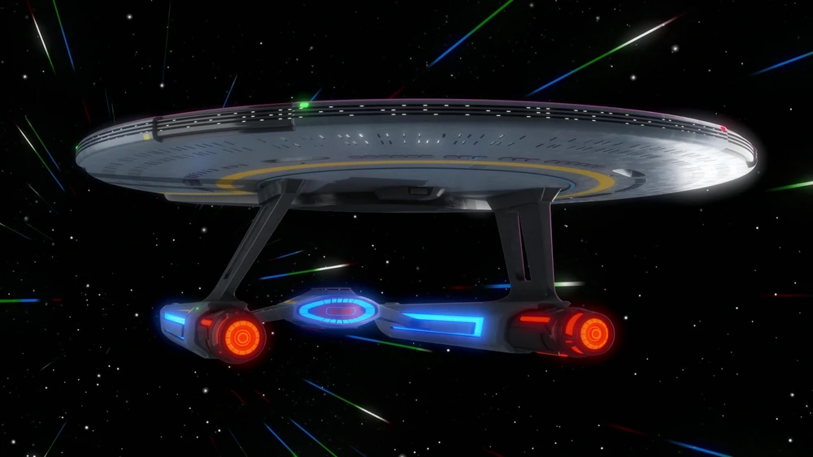
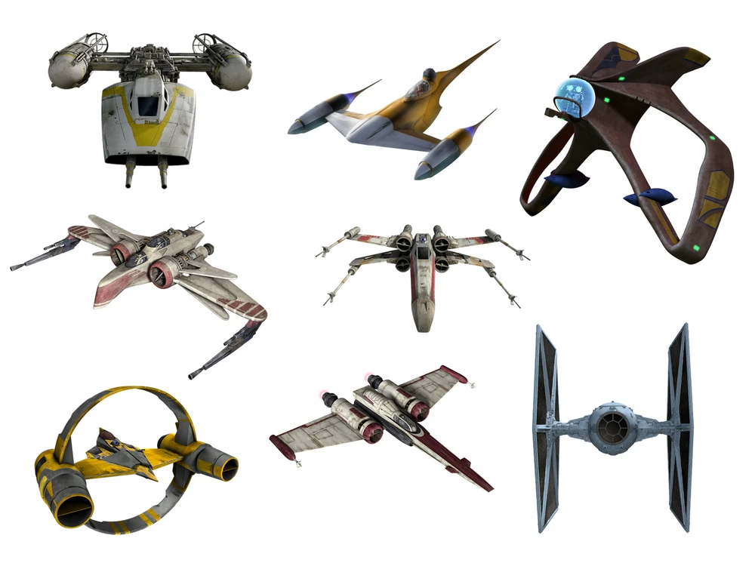
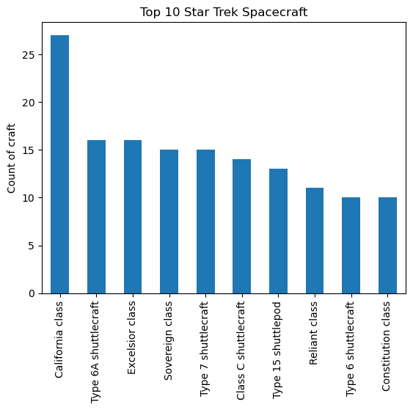
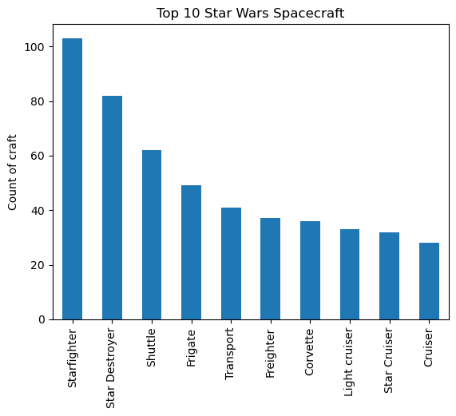
Spacecraft Data
Star Trek has 1443 named spacecraft, only 544 had class data, with 189 classes between them.
The most prevalent class was the California Class
Star Wars had 904 named spacecraft with 193 classes.
The most frequent class was starfighter.

Slide 26
Spacecraft Data
Star Trek/STAPI Data
No size data other than Number of Decks
Only 87 of the 1312 ships had data
Very simple float data
Star Wars/Wookieepedia Data
Data for length, width, height, and diameter. Data also ranged from meters and kilometers to feet and unknown types:
Stuck with length because it was most available
Converted everything to meters for consistency
Stripped what could not be identified
203 of the 904 ships had length data

Slide 27
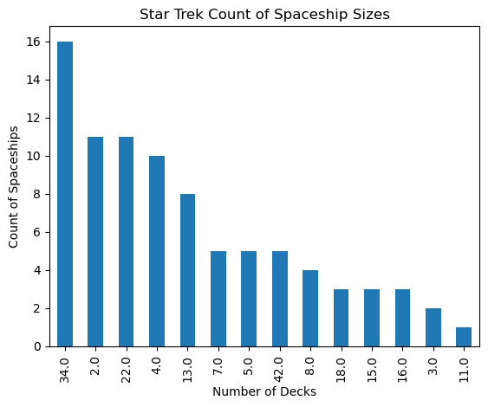
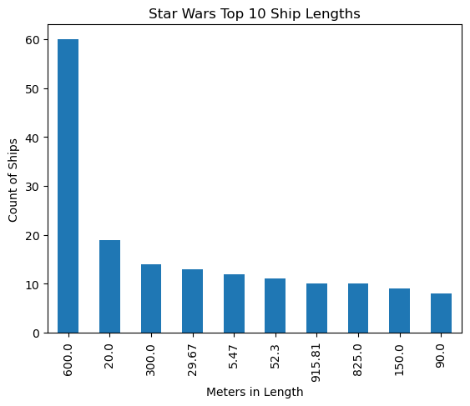
Spacecraft Data
Star Wars/Wookieepedia Data
The most common length of ships was 600 meters.
Star Trek/STAPI Data
The most common number of decks for a named ship is 34.

Slide 28
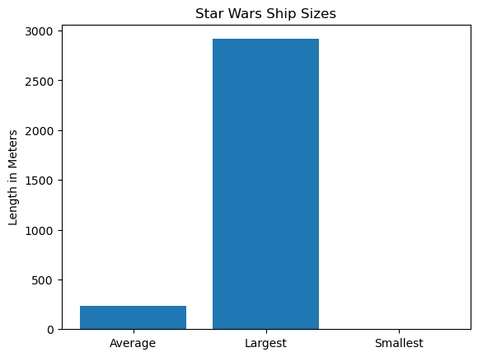
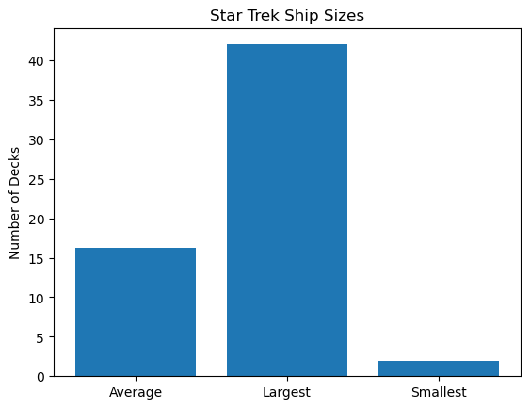
Spacecraft Data
Star Trek/STAPI Data
Average is 16
Largest is 42
Smallest is 2
Star Wars/Wookieepedia Data
Average is 233.89 meters
Largest is 2915.84 meters
Smallest is 2.6 meters

Slide 29
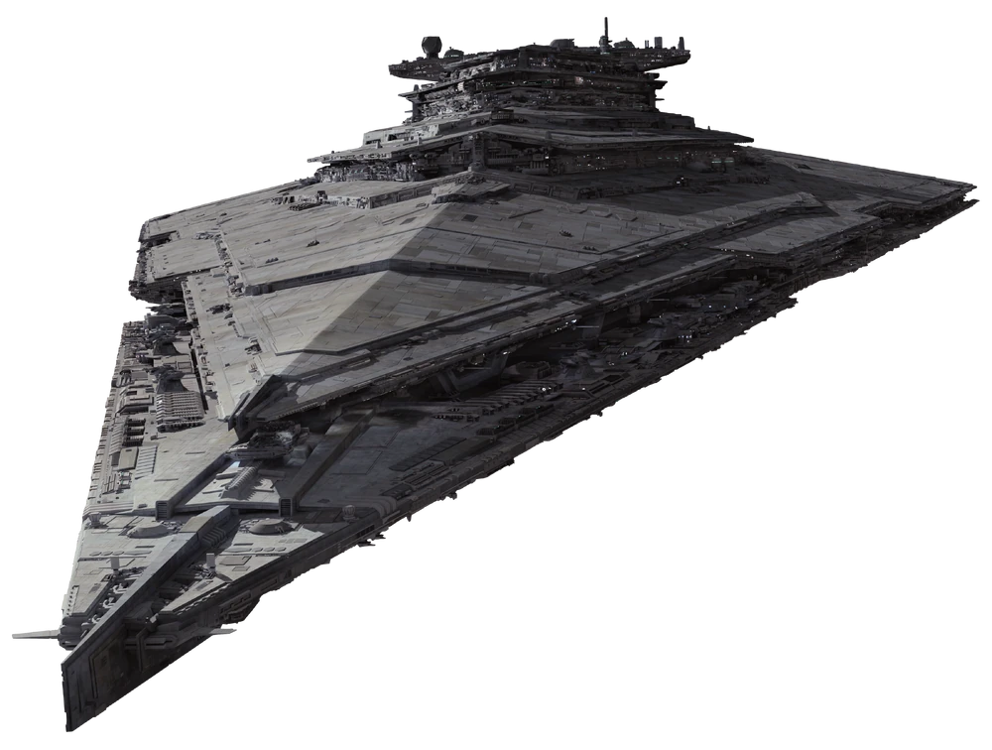
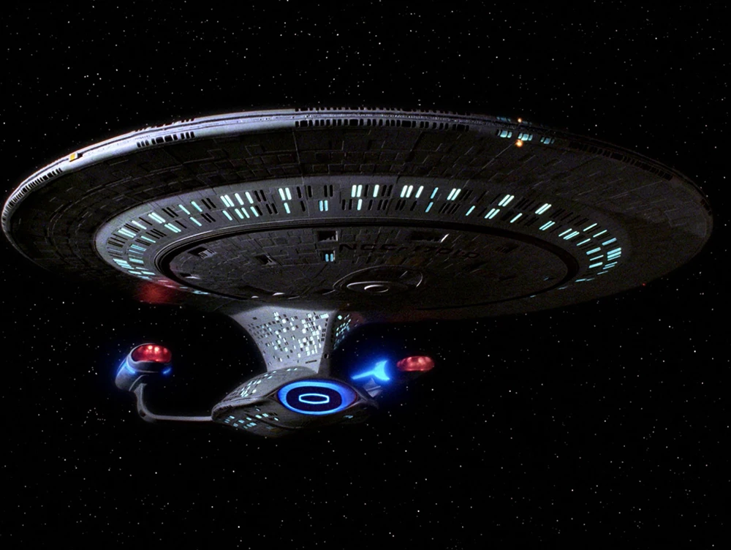
Spacecraft Data
Star Trek/STAPI Data
The average class is around 16 stories tall.
The tallest is 42 stories tall, which is the Galaxy class spacecraft..
Star Wars/Wookieepedia Data
The average is length is around 2.3 football fields long.
The largest is 1.8 miles long, which is the Resurgent-class Star Destroyer

Slide 30
Spacecraft Data
Star Trek/STAPI Data
Ships are more easily categorized
Consistency in measurements
Majority of the ships are fairly large vessels
Star Wars/Wookieepedia Data
Data is very messy and difficult to categorize
Some consistency in measurements
Majority of the ships are smaller.

Slide 31
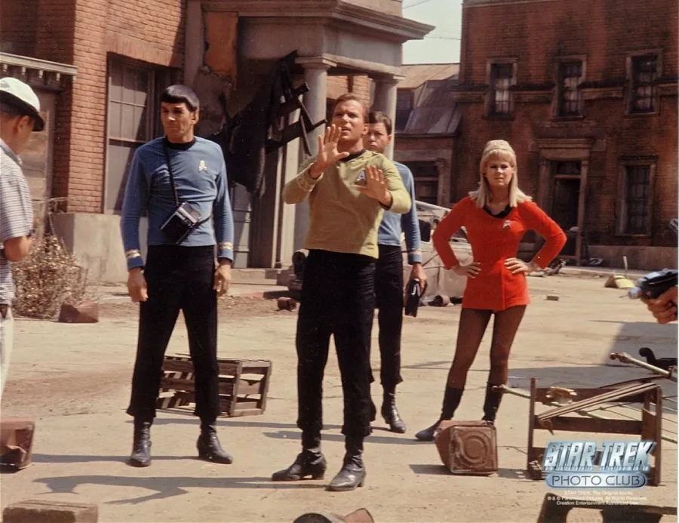
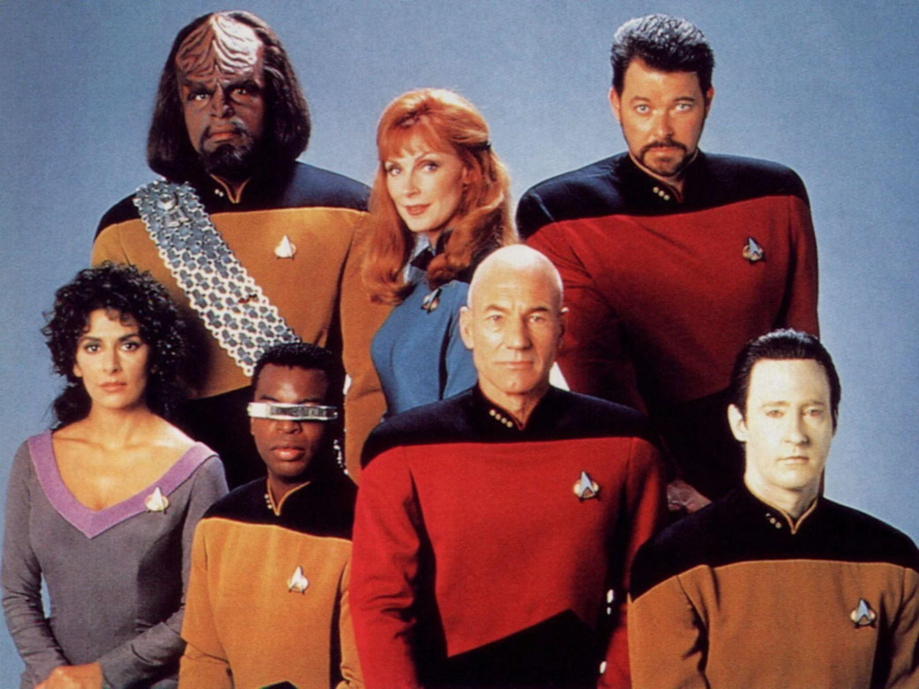
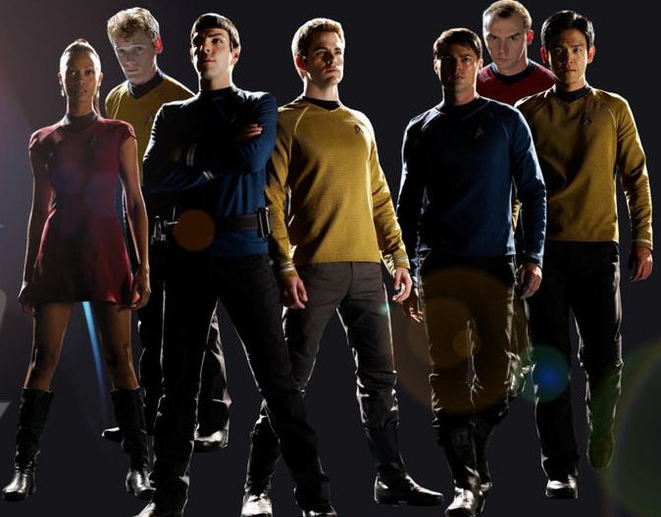
Final Thoughts
Both universes and their data compliment each other.
Star Trek is a very clean, orderly, easily categorized universe. STAPI is well thought out, very easily digestible, and very easy to use. However, if data is not easy to assimilate it is not added. It leaves little room for dissimilar data, which is treated as troublesome or problematic and discarded or omitted.

Slide 32
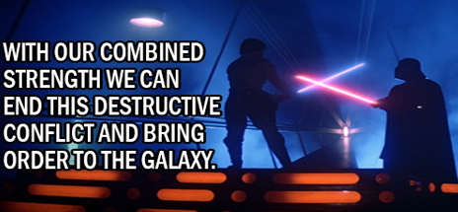
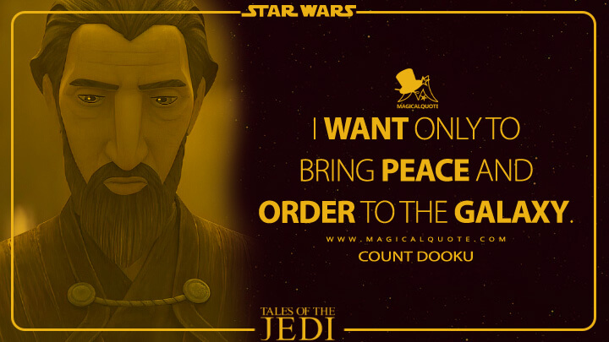
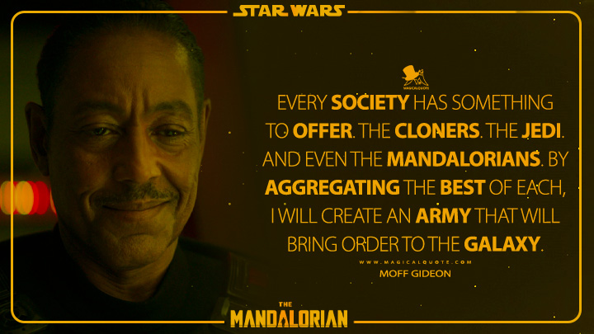
Final Thoughts
Star Wars is a very messy universe that is not always easy to follow, and its data is no different. There are conflicting views on everything even within the same groups and factions, and there is an aversion to order. Most of the time when order is mentioned in Star Wars, it is with a very negative connotation.
Wookieepedia data is no different and mirrors the views of its universe and its fans. Being a wiki, there can be disagreements on what is allowed and what is acceptable. Two years ago, there were admins who were banned for bullying and intimidating of transpeople.
With all its problems, the data and the freedom are there, even with the ugliness. There are great fans, such as the 501st. Star Wars tries to promote freedom, to give fans hope, to give everyone a face and a voice, even in the face of bigotry and spite.

Slide 33
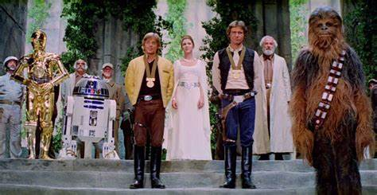
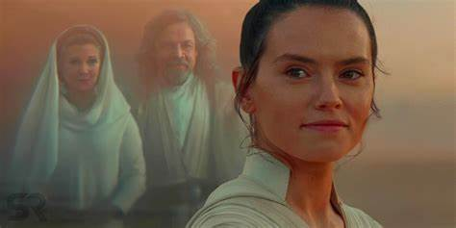
Final Thoughts
Both universes are a lot of fun. Both datasets are useable. However, I believe the Star Wars universe and data have more to use and allow for a greater degree of freedom in exploration and discovery of its universe. While it is much more challenging, I believe the struggles can inspire and provide hope.

